Slide 1
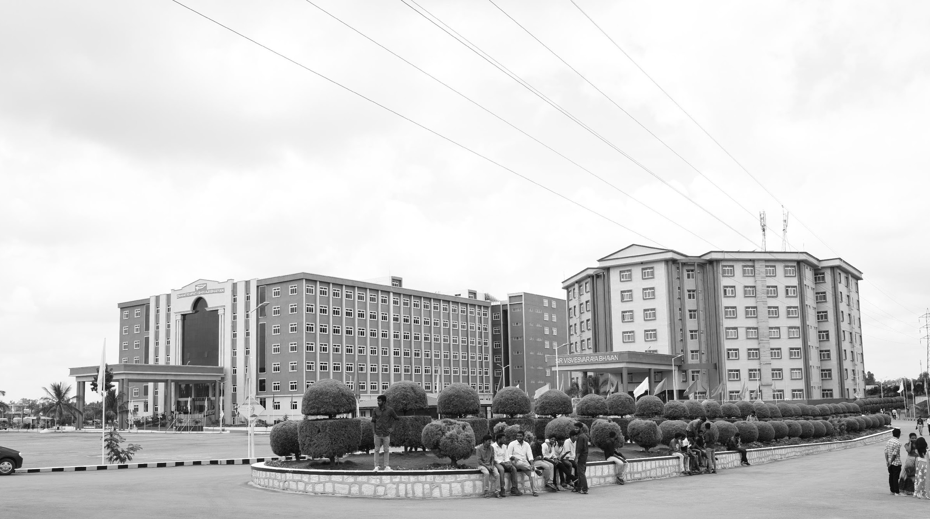
AgriRoute: Smart Vehicle Monitoring System for Farmers in Agricultural
Transport with Real-Time Alerts.
Mid-Review 3
AY 2021-25
GITAM (Deemed-to-be) University
Major Project
Project ID: C15
Department of Electrical Electronics and Communication Engineering
Project Team:
MEGHANA B (BU21EECE0100559)
MATAM MANASWINI (BU21EECE0100545)
SHREE RAKSHA B N (BU21EECE0100552)
Project Mentor:
Dr. Sunita Panda
Associate Professor, EECE Department,
GITAM DEEMED TO BE UNIVERSITY, BENGALURU CAMPUS.
www.gitam.edu

Slide 2
Objective and Goals
REVIEW 1
Objective
· To create a cost-effective Vehicle Tracking System (VTS) using Arduino, GPS, and GSM modules to promote widespread adoption among farmers with limited technical skills.
· To design the system to be scalable, allowing for the integration of additional sensors like temperature, humidity, or load monitoring to meet various agricultural needs and maintain optimal conditions for transported goods.
· To develop an easy-to-use mobile app that offers real-time location tracking, delivery notifications, and transaction history, facilitating smooth communication and coordination among farmers, transporters, and buyers.
Goals
Main Goals :
· Ensure system designed provides accurate real-time location of the vehicle using GPS.
· Incoporate mapping services, such as Google Maps, to display vehicle location data.
· Implementing the tracking features for both clients and the customers.
Additional Goals :
· Ensure that the application is compatable for both iOS and Android platforms to reach a broader user base.
· Enable the feedback system from client for enhancing customer support.

Slide 3
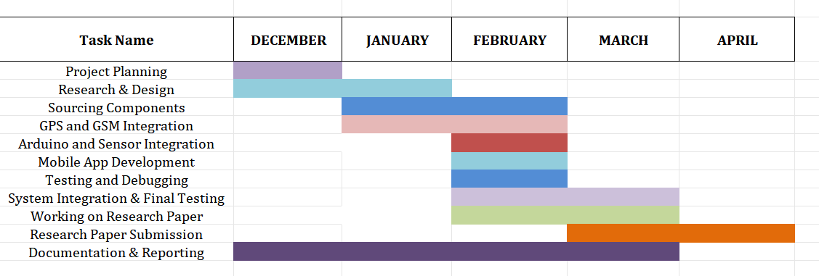
REVIEW 1
Gantt Chart - Project Plan

Slide 4
Literature Survey
REVIEW 1
Key Publications
RESEARCH PAPER DETAILS | METHODOLOGY | MERITS | RESEARCH GAP | LINK
Real Time Vehicle Tracking Scheme by Analysing Spatial Position through GPS and GSM Author Name : T. Sindhu ; L. SaiRamesh Date : 2020 Publication Name : IRJMETS | The system integrates GPS, GSM, and Android applications to enable real-time tracking, geo-fencing, and speed detection, ensuring accurate monitoring and notifications. It provides multi-device compatibility through Google Maps and intuitive interfaces, making it accessible for various users and adaptable to diverse applications. | Comprehensive features like real-time monitoring, geo-fencing. User-friendly design and custom GSM alerts ensure ease of use and quick responsiveness, even in emergencies. | The system lacks alternatives for GPS unavailability, energy-efficient tracking. It does not address scalability. | https://www.irjmets.com/uploadedfiles/paper/volume2/issue_9_september_2020/4048/1628083160.pdf

Slide 5
REVIEW 1
RESEARCH PAPER DETAILS | METHODOLOGY | MERITS | RESEARCH GAP | LINK
Live GPS Location Tracking using GPRS Author’s Name : Jayesh Sharma Sai Deepak Guggilla Shashi pidugu Dr. Pandya Vyomal Date: 2021 Publication Name: IJRASET | The system uses GPS and GSM modules connected to a microcontroller to track and transmit vehicle location. Data is uploaded to a cloud server for monitoring. Sensors for collision detection and tampering are integrated. IoT enables predictive analysis, automated alerts, and real-time responses to enhance vehicle security. | AI and IoT enable predictive maintenance and theft detection. It offers scalability for fleet management, while cloud integration allows remote access. The design emphasizes cost-efficiency, user-friendly interfaces, and low power consumption for long-term usability. | The system design is limited to single-vehicle tracking. The paper does not propose a user-friendly interface or mobile app for real-time monitoring. Continuous GPS and GSM module operation may drain power quickly, making the system less viable for long-term vehicle tracking without a stable power source. | https://www.ijraset.com/fileserve.php?FID=36081

Slide 6
REVIEW 1
RESEARCH PAPER DETAILS | METHODOLOGY | MERITS | RESEARCH GAP | LINK
Vehicle Tracking System using GPS and GSM Technology Author’s Name : Niraj Sakla Avinash Pawar Prof. Anamika Dhawan Date: 2022 Publication Name: IJRASET | A microcontroller is used to connect the GPS and GSM modules. The GPS module captures the vehicle’s location through latitude and longitude coordinates. This location data is then sent to the user’s mobile phone via the GSM module as an SMS. Serial communication is used to transfer data between the GPS and the system. | The system provides real-time tracking, allowing continuous monitoring of vehicles. It is cost-effective. Users receive instant SMS alerts with the vehicle's location, making it easy to track. | The system does not include any features for optimizing energy use. It focuses solely on tracking the vehicle's location without offering additional functionalities. | https://www.ijraset.com/best-journal/vehicle-tracking-system-using-gps-and-gsm-technology

Slide 7
REVIEW 1
RESEARCH PAPER DETAILS | METHODOLOGY | MERITS | RESEARCH GAP | LINK
Research and Appropriate Implementation on Vehicle Tracking system using IOT Author Name : Anish Khanal, Manoj Shreshta Date : February, 2024 Publication Name : IJFMR | Combines GPS, microcontrollers, and cloud storage to track vehicles and manage data efficiently. Enables real-time tracking while ensuring data privacy and security compliance. | Incorporating machine learning for predictive maintenance and optimized routing highlights an innovative approach to fleet management, setting the system apart from traditional tracking solutions. The study’s focus on data privacy, security, and regulatory compliance demonstrates an understanding of the ethical implications of IoT-based tracking systems. | Although the framework is described as scalable, there is no in-depth analysis of how the system performs under increasing fleet sizes or varying network conditions. IoT devices often face challenges related to power consumption, but this aspect is not addressed, which is critical for long-term deployments. | https://www.ijfmr.com/papers/2024/1/12591.pdf

Slide 8
REVIEW 1
RESEARCH PAPER DETAILS | METHODOLOGY | MERITS | RESEARCH GAP | LINK
Development and Performance analysis of a GPS GSM Guided System for Vehicle Tracking Author’s Name : B. Adaramola, Ayodeji Olalekan Salau Date: 2020 Publication Name: ICCAKM | The GPS-GSM-based vehicle tracking system uses hardware components such as an Arduino microcontroller, GSM module, GPS module, and vibration sensors. The system integrates these components through software development in the Arduino IDE, which processes inputs and transmits outputs via SMS. | The system offers real-time tracking and an anti-theft feature. It allows multiple vehicles to be tracked efficiently. | The system uses manual data interpretation instead of internet-based tracking, limiting its efficiency in real-time updates and monitoring. | https://ieeexplore.ieee.org/stamp/stamp.jsp?tp=&arnumber=9051533&tag=1

Slide 9
REVIEW 1
Key Resources :
Whitepapers and Research Articles :
Agricultural Supply Chain Challenges and Solutions:
Link: https://www.researchgate.net/publication/271700201_Agricultural_Supply_Chain_and_Logistic_-_trends_and_challenges
Explores challenges in agricultural logistics, including delays, spoilage, and inefficiencies, with proposed solutions.
Minimizing Spoilage and Delays in Supply Chains:
Strategies to mitigate risks in supply chains, including real-time monitoring and predictive analytics.
Link: https://sloanreview.mit.edu/article/reducing-the-risk-of-supply-chain-disruptions/
Focuses on technology-driven solutions to reduce delays and enhance supply chain reliability.
Link: https://www.oracle.com/in/scm/reduce-supply-chain-disruptions/

Slide 10
REVIEW 1
Technology Implementation Guides
Arduino Uno R3
Link: https://vayuyaan.com/blog/arduino-uno-r3-complete-guide-for-beginners/?srsltid=AfmBOoqvCh2y10AAmdDJj1dp1uDlPeXeoNhaPlvJ6o-rFrTXELKq2Lkr
A detailed introduction to using the Arduino Uno R3, with setup instructions and example projects.
GPS Modules (Neo-6M)
Link: https://randomnerdtutorials.com/guide-to-neo-6m-gps-module-with-arduino/
Comprehensive setup and interfacing guide, including example codes and troubleshooting tips.
GSM Modules
Link: https://robocraze.com/blogs/post/interfacing-gsm-module-with-arduino?srsltid=AfmBOorI-UlgudZ6Dmzmqeq8ZvjzVCx-88QlL0qAGP49HWlogq8wpFvA
Explains step-by-step connections and code examples for sending/receiving SMS and calls.
DHT11 Sensors
Link: https://www.electronicwings.com/sensors-modules/dht11
Covers temperature and humidity sensing with wiring diagrams and code snippets.
HX711 Load Cells
Link: https://randomnerdtutorials.com/arduino-load-cell-hx711/
Guides users in measuring weight using HX711 and Arduino, with calibration tips.

Slide 11
REVIEW 1
Existing Implementations :
Products:
GPS Tracker on Amazon:
Link: https://amzn.in/d/iBu4o3z
A compact GPS tracker for vehicles with real-time tracking capabilities. It provides location updates and theft detection with SIM-based communication.
GSM GPS-Based Vehicle Theft Detection and Tracking System:
Link: https://projectsfactory.in/product/gsm-gps-based-vehicle-theft-detection-and-tracking/
A pre-designed project offering GSM and GPS-based theft detection and vehicle tracking. It alerts the owner in case of unauthorized access and provides location updates.
GSM and GPS-Based Vehicle Tracking System:
Link: https://projectsfactory.in/product/gsm-and-gps-based-vehicle-tracking-system/
A ready-to-use system for tracking vehicles using GSM and GPS modules. It sends vehicle location data via SMS and is ideal for monitoring fleet movement.
TRACKER Pre-Recharged SIM GPS Tracker on Amazon:
Link: https://www.amazon.in/TRACKER-Pre-Recharged-SIM-GPS-Tracker/dp/B0DHXY8Q4C
A portable GPS tracker with pre-recharged SIM, offering easy plug-and-play functionality. It enables location monitoring and anti-theft protection for vehicles.

Slide 12
REVIEW 1
Open Source:
Location Tracking System Using Arduino:
Link: https://justdoelectronics.com/gps-gsm-based-location-tracking-system-using-arduino/
A DIY tutorial on building a GPS and GSM-based tracking system using Arduino. It demonstrates how to fetch location coordinates and send them via SMS.
GSM GPS-Based Vehicle Tracking System (Electronics For You):
Link: https://www.electronicsforu.com/electronics-projects/hardware-diy/gsm-gps-based-vehicle-tracking-system
A detailed guide for creating a vehicle tracking system with GSM and GPS modules. It explains hardware assembly and software coding for tracking functionality.
GitHub:
Real-Time Vehicle Tracking System:
Link: https://github.com/rohitkrtiwari/real-time-vehicle-tracking-system
A repository featuring an Arduino-based vehicle tracking system. It uses GPS and GSM modules for real-time updates and includes sample code for integration.
Vehicle Tracking System:
Link: https://github.com/faem/vehicle-tracking-system
A repository providing a GPS and GSM-based tracking solution. It features Python-based software for tracking and data analysis.

Slide 13
REVIEW 1
Traccar:
Link: https://github.com/traccar/traccar
An open-source GPS tracking platform supporting multiple devices and protocols. It offers real-time tracking and geolocation services with a user-friendly interface.
ESP32-Based IoT Tracking System:
Link: https://github.com/ranizouaoui/ESP32-Based-IoT-Tracking-System
A repository showcasing an IoT-based tracking system using the ESP32 microcontroller. It integrates GPS and GSM modules for precise tracking.
TraceIT:
Link: https://github.com/race2infinity/TraceIT
A GitHub project for vehicle tracking and fleet management. It uses GPS technology and offers detailed tracking analytics.

Slide 14
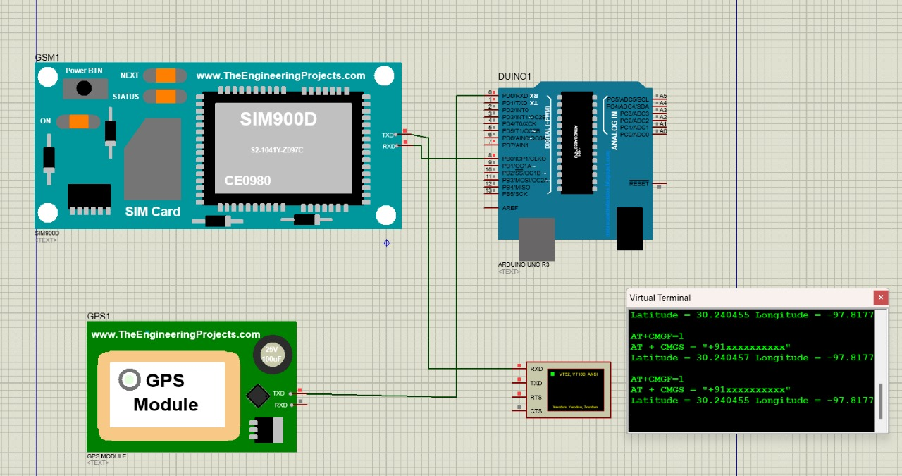
REVIEW 1
RECAP OF SOFTWARE SIMULATION IN PROTEUS 8 :

Slide 15
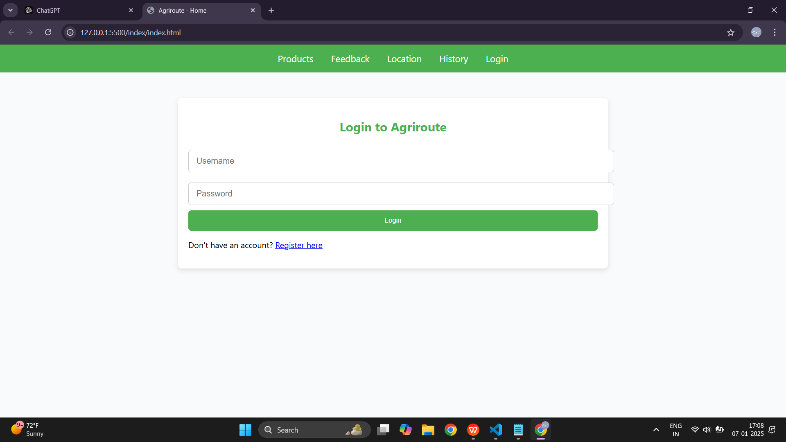
REVIEW 1
APP & WEBSITE BASIC DESIGN OUTLINE :

Slide 16
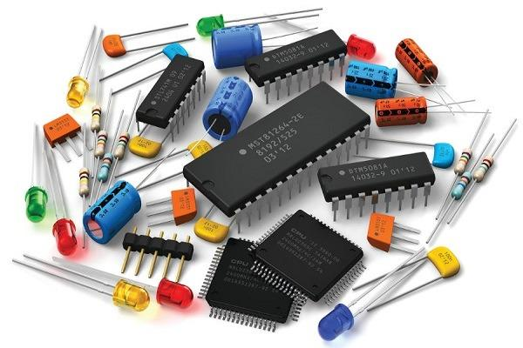
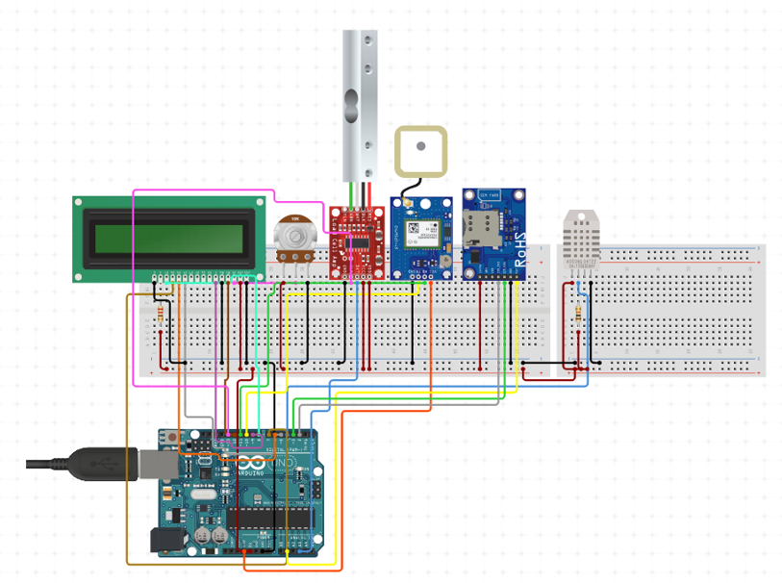

REVIEW 2
WORK PROGRESS FROM REVIEW-1 TO REVIEW-2
:
:
ASSEMBLING COMPONENTS
100% WORK PROGRESS
CIRCUIT DESIGNING
50% WORK PROGRESS
APPLICATION DEVELOPMENT
50% WORK PROGRESS

Slide 17


REVIEW 2
WORK PROGRESS FROM REVIEW-1 TO REVIEW-2
:
:
LIBRARIES & CODE BUILDING 30% WORK PROGRESS
GITHUB REPO UPDATION
70% WORK PROGRESS

Slide 18
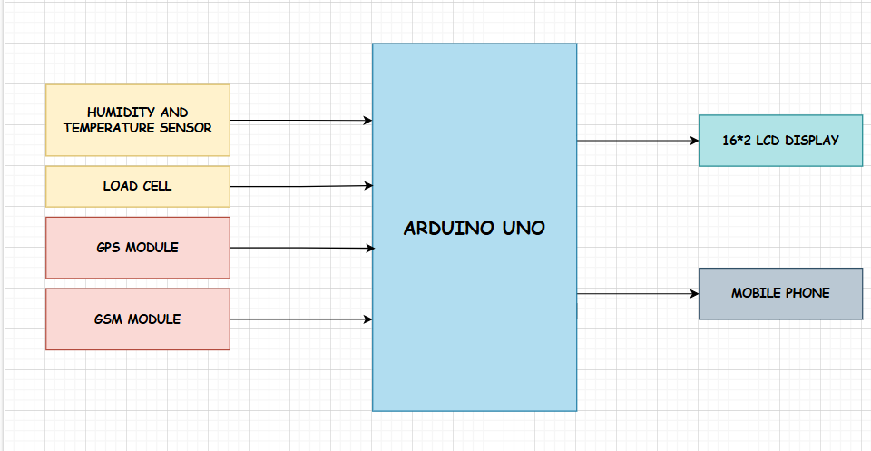
Architecture
REVIEW 2
Structural Diagram
Monitoring Conditions: Temperature and humidity sensor ensures perishable commodities are transported under ideal conditions.
Load Management: Load cell measures item weight during loading and unloading, preventing overloading and ensuring precise delivery counts.
Real-Time Tracking: GPS module tracks vehicle location in real time.
Alerts: GSM module sends SMS alerts to mobile phones with updates on location, weight changes, and abnormal environmental conditions.
Central Controller: Arduino Uno processes sensor data.
Display: 16x2 LCD screen shows statistics like location, temperature and weight.
Fig: Block diagram of Vehicle Tracking System

Slide 19
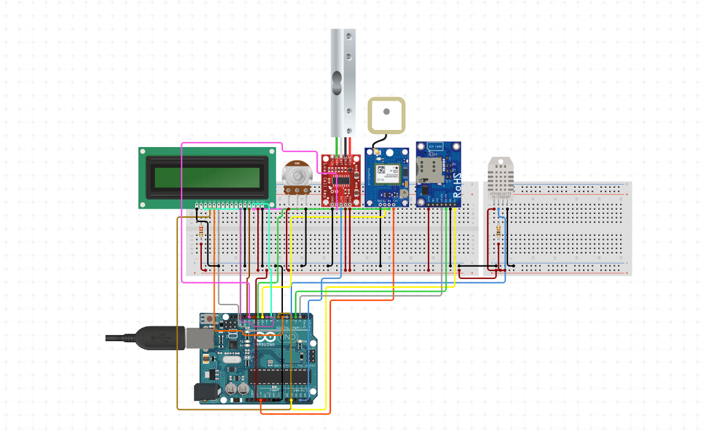
VISUALIZATION OF THE AGRI-ROUTE CIRCUIT :
REVIEW 2

Slide 20
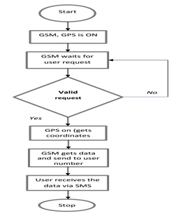
Behaviour Diagram
REVIEW 2
The VTS integrates GSM, GPS, temperature and humidity sensors, and a load cell for monitoring and real-time updates.
Initialization Step: The system activates the GSM, GPS modules, and sensors to prepare for data collection.
Waiting for User Request:
The system remains idle until it receives a valid user request.
Processing the Request:
The GPS module retrieves the vehicle's location.
Sensors collect data on temperature, humidity, and weight.
Transmitting Information: GSM module sends an SMS with location, environmental conditions, and weight details to the user's mobile.
Reset for Next Cycle: The system resets after sending the information to handle subsequent user requests.
Fig: Flowchart illustrating algorithm for VTS.

Slide 21
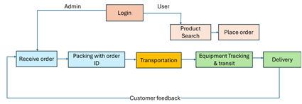
REVIEW 2
Behaviour Diagram
A user-friendly mobile app will be designed for easy access to monitoring data and system controls.
The system will sense and address product requirements across the value chain, from the farming field to customer hands.
Fig: Integrated Mobile Application for End-to-End Value Chain Management

Slide 22
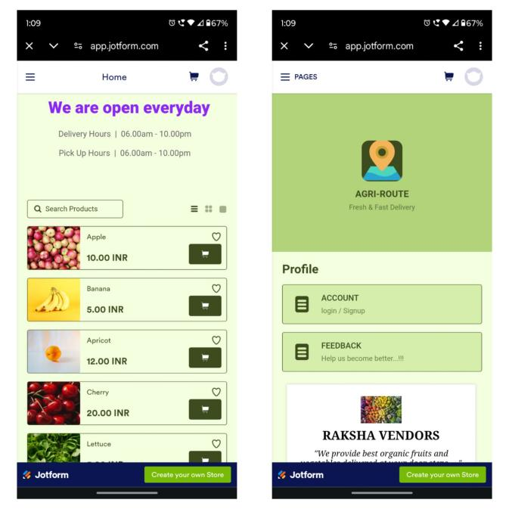
REVIEW 2
APPLICATION FEATURES:
SUPPORTS BOTH ANDRIOD & IOS
RECIEVES FEEDBACK VIA EMAIL
RECIEVES ACCOUNT LOGIN DETAILS VIA EMAIL
CAN BE INSTALLED OR USED AS WEB APPLICATION
COMPATIBLE FOR BOTH DESKTOP AND MOBILE PLATFORMS

Slide 23
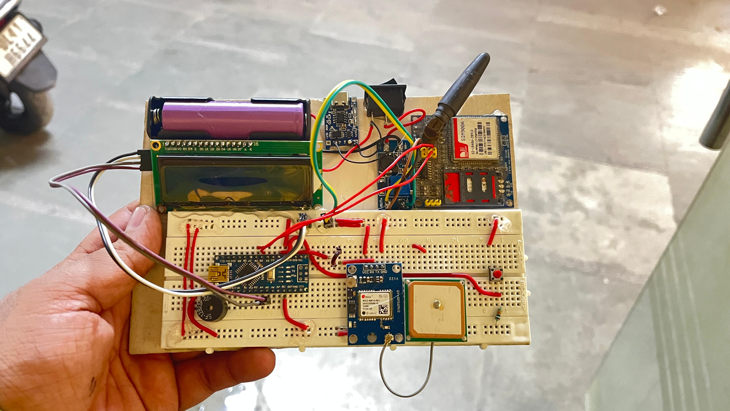
REVIEW 3

Slide 24
REVIEW 3
Use Cases & Testing
Use Cases for the Vehicle Tracking System :
Agricultural Logistics – Helps farmers track transportation of goods, ensuring timely deliveries and reducing spoilage.
Fleet Management – Monitors commercial vehicle fleets, optimizing routes and reducing fuel consumption.
Emergency Response – Enables real-time tracking of ambulances and fire trucks for faster emergency services.
School Bus Tracking – Ensures student safety by allowing parents and schools to monitor bus locations.
Cold Chain Logistics – Tracks temperature-sensitive goods like dairy, vaccines, and perishable foods in transit.
Public Transport Optimization – Improves efficiency and passenger experience by tracking buses and taxis in real-time.
Rental & Shared Vehicles – Helps rental services track and manage their vehicles remotely for better asset management.

Slide 25
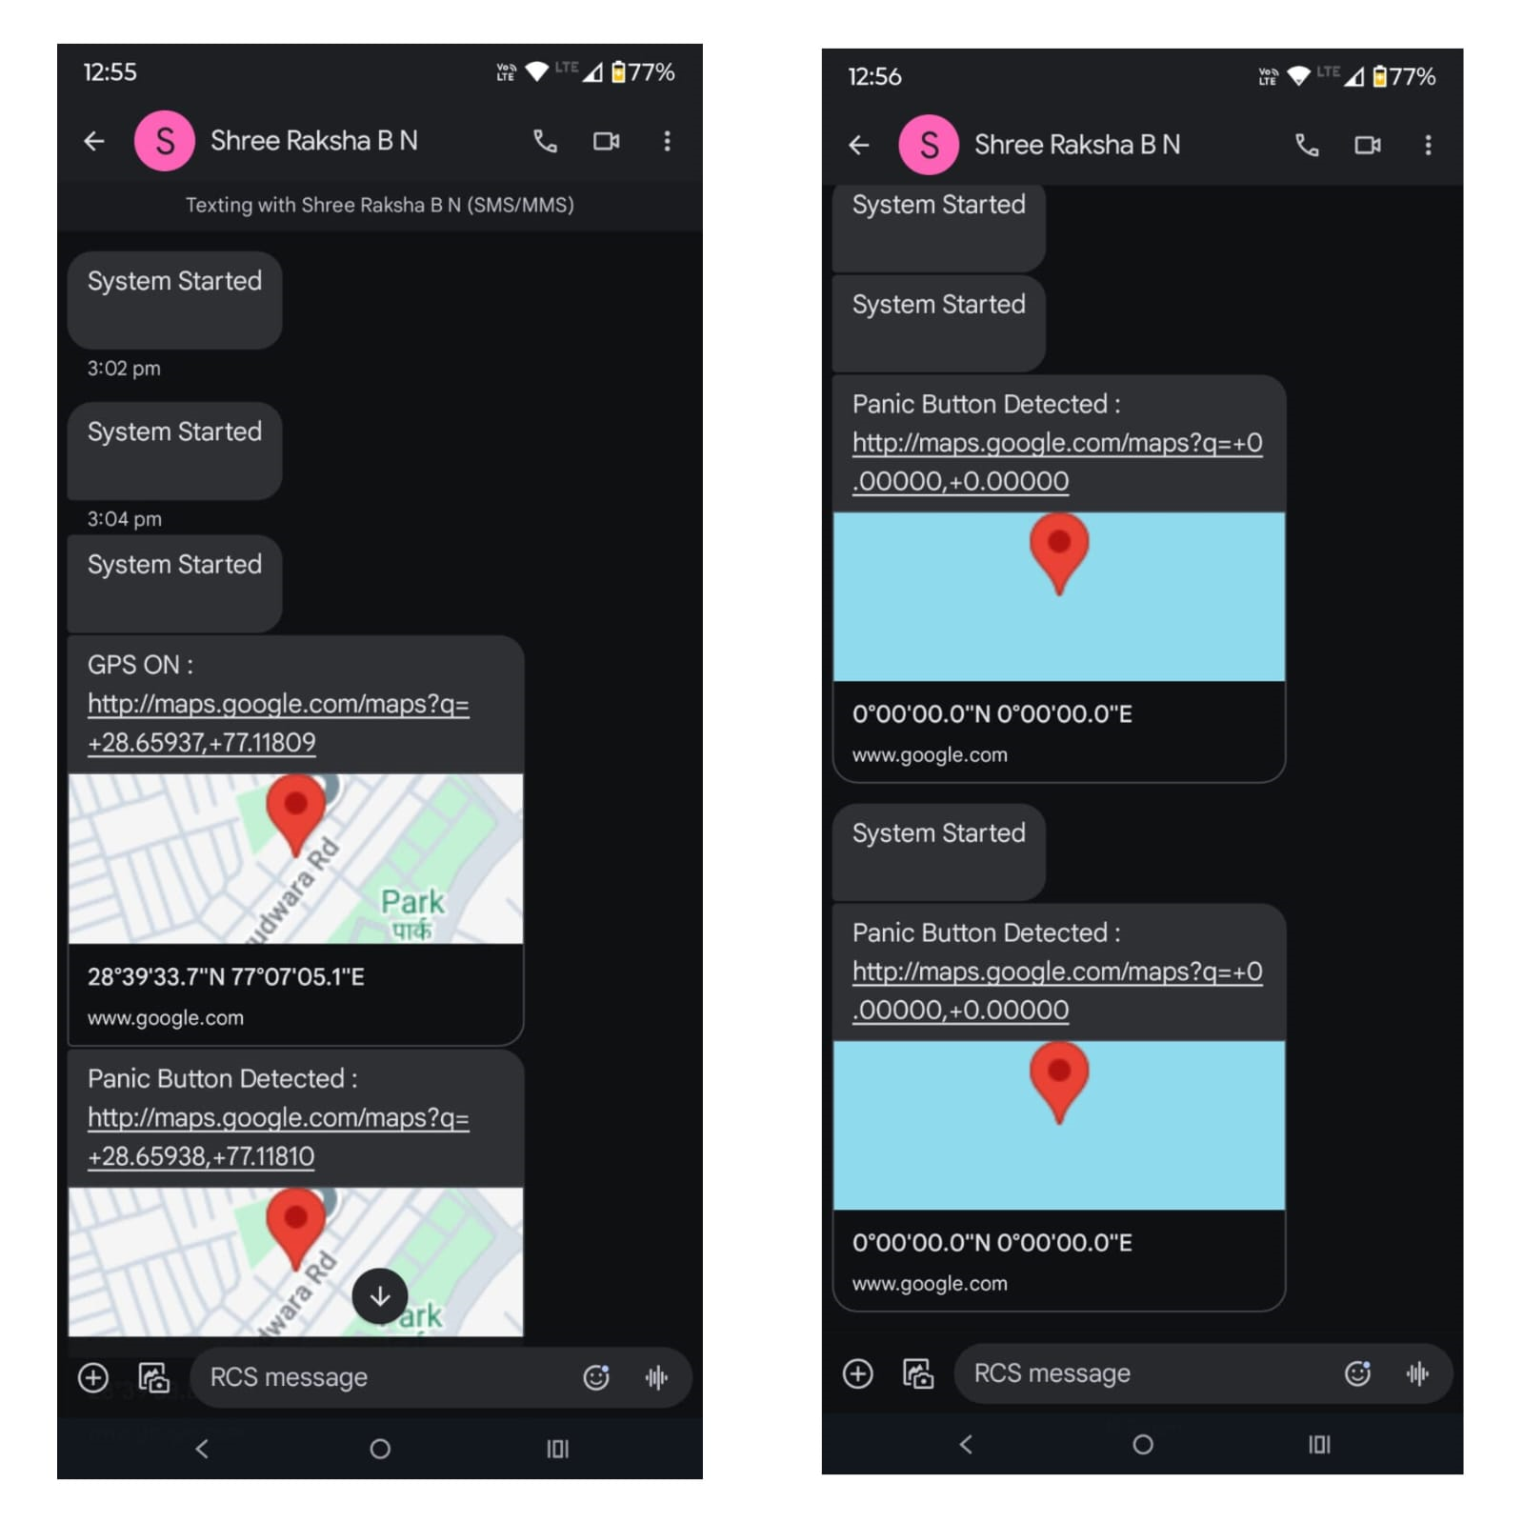
REVIEW 3
Implementation and Results – Iteration 1
Iteration 1 : Results
Accurate Tracking –
The system successfully provided real-time location updates using GPS and GSM.
Reliable Communication –
SMS-based tracking worked well in low-internet areas, ensuring accessibility.
Power Efficiency –
The use of 18650 lithium-ion batteries improved battery life and system stability.
User-Friendly Application –
The Agri-Route app working to facilitate seamless user-friendly.

Slide 26
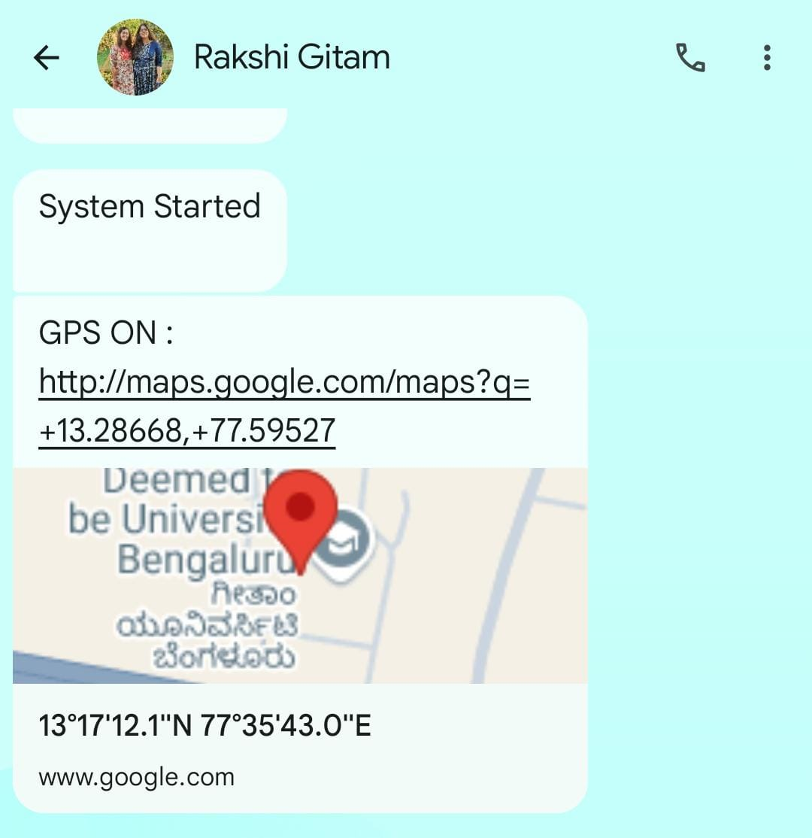
Implementation and Results – Iteration 2
REVIEW 3
Iteration : Results + Validation against the use cases and test cases
Results :
GPS & GSM Functionality – Successfully provided real-time tracking.
SMS-Based Tracking – Location updates were sent and received without internet dependency.
Panic Button – Emergency alerts with location details were triggered successfully.
Power Performance – 18650 lithium-ion batteries ensured stable operation.
Agri-Route App – Enabled basic transactions, but UI improvements are needed.
Validation :
Accurate Tracking – System provided real-time location updates as expected.
Reliable Emergency Alerts – Panic button effectively sent location-based notifications.
Transaction Processing – Agri-Route app functioned but requires enhancements.
Offline Functionality – SMS-based tracking worked without internet access.

Slide 27
REVIEW 3
Contribution
Team Progress and Movement
Completed integration of the components
Application Outline has been designed for easy access
Targetting IEEE Conference paper (submission on 15th April)
IEEE International Conferences on Network, Multimedia, and Information Technology (NMITCON)
Individual Contribution
Key contributions: MEGHANA B
Circuit & Code Designing, Application Building
Key contributions: MATAM MANASWINI
Circuit & Code Designing, Literature survey
Key contributions: SHREE RAKSHA B N
Documentation, Circuit Designing, App buidling

Slide 28
REVIEW 3
Conclusion & Future Work
Summary and Conclusion :
GPS & GSM-based Tracking –
Uses Arduino Nano and SMS-based tracking for accurate location monitoring, even in rural areas.
Efficient & Secure System –
Features a panic button, Agri-Route app for direct trade, and 18650 batteries for power efficiency.
Scalable IoT Solution –
Overcomes GPS & power issues, enhances supply chain management, and ensures cost-effective logistics.
Future Work :
Cloud-Based Tracking –
Integrate a web dashboard for continuous GPS tracking, reducing reliance on SMS.
Advanced Mobile App –
Develop a custom Android/iOS app with live tracking, push notifications, and analytics.
Improved GPS & Security –
Upgrade to multi-band GPS modules and implement encryption, geofencing, and motion detection.

Slide 29
THANK YOU
Have a Great Day !

